Slide 1
TITLE SLIDE
EML6934 INDUSTRY PRACTICUM Dr. Karen Ehlers
MODULE 6
Effective presentations I

Slide 2


About the Team
Oshoriame Olorife
Team Member
Aerospace Engineering
Graduate Student

Slide 3
Background
Project: Deliverymeds
Problem: Wilmont’s wants to expand their pharmaceutical delivery system to consumers by using drone delivery and initiating a pilot project.
Goal: Provide a drone delivery alternative to Wilmont’s existing consumers by creating a proper interface, customizing four prototype drones, and ensuring successful delivery of Wilmont’s products
Constraints:
$750,000 budget
January 5th- November 30th timeline
Gainesville area
Narrator: Samrudh Untgod Preetham
Notes:
Gainesville area constraint - 4 pharmacies; pilot project does not include consumers of apartment buildings

Slide 5

Earned Value Metrics
Baseline - approved version of a scope statement that is used as a basis for comparison
Percent complete - the percentage of the project that is currently complete
Percent Complete (PC) = Actual Duration (AD) ÷ Total Duration (D)
Planned Value (PV) - budgeted cost
Earned Value (EV) - current cost or progress of the project
Budget at Completion (BAC) - total projected budget
Benchmark for computing overruns and underruns
Schedule Variance (SV) - measures if project is on schedule
Schedule Variance (SV) = EV (Earned Value) – PV (Planned Value)
Narrator: Margy Orozco
Notes:
work breakdown structure (WBS) and it associated WBS dictionary that can be changed only through formal change control procedures and is

Slide 6
Earned Value Metrics
Cost Variance (CV) - indicates how much over or under budget the project is.
Cost Variance (CV) = Earned Value (EV) – Actual Cost (AC)
Cost Performance Index (CPI) - budget efficiency level
Cost Performance Index (CPI) = Earned Value (EV) ÷ Actual Cost (AC)
Schedule Performance Index (SPI) - schedule efficiency level
Schedule Performance Index (SPI) = Earned Value (EV) ÷ Planned Value (PV)
Estimate To Complete (ETC) - the expected remaining cost
Estimate to Complete (ETC) = (BAC – EV) ÷ CPI
Narrator: Margy Orozco

Slide 7
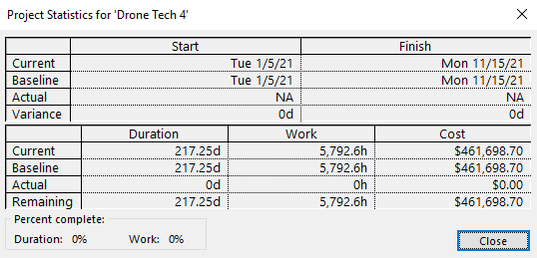
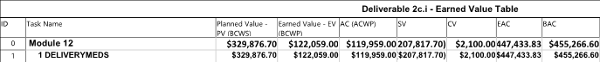
Deliverymeds Status
Status date: 7/30/2021
Percent complete: 40%
Project status
BAC = $455,266.60
PV = $329,876.70
EV = $122,059.00
AC = $119,959.00
Microsoft Project Statistics on current progress
Earned Value information derived from MSP
Narrator: Anthony Noto

Slide 8
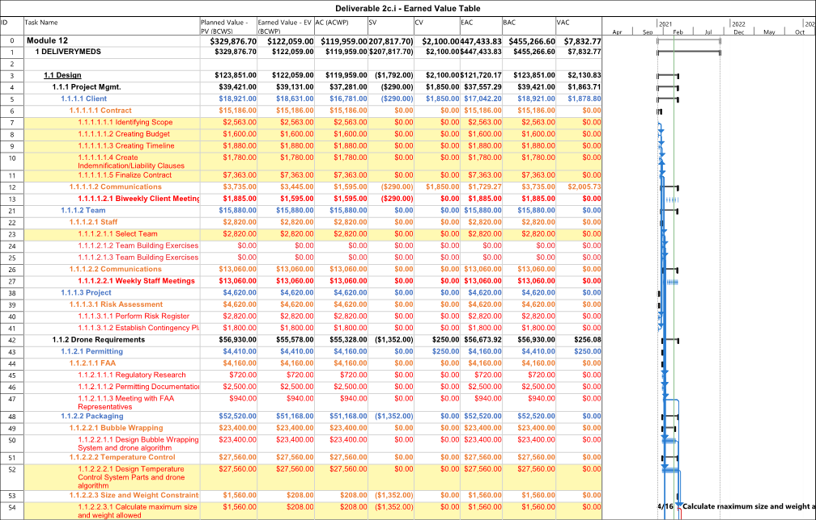
Narrator: Anthony Noto
Overall Earned Value Table up to 40% Completion

Slide 9
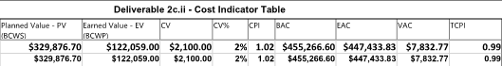
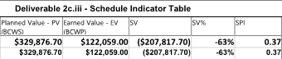
Deliverymeds Status
Further cost information
CV = $2,100.00
CPI = 1.02
Further schedule information
SV = -$207,817.70
SPI = 0.37
Microsoft Project information on current cost progress
Narrator: Anthony Noto
Microsoft Project Statistics on schedule progress

Slide 10

Causes of Delay
COVID-19 Pandemic
Contractual Agreements
Unavailable to meet in person
Federal Permitting
Unavailability of governmental permitting agencies
Engineering Staff
Contracting COVID-19
Wilmont’s Staff
Lesser communication, cannot proceed with deliverables
Photo: Centers for Disease Control and Prevention
Narrator: Anthony Noto

Slide 11


Corrective Actions
COVID-19 testing of employees
Provide PPE to on-site employees
Delegate tasks to employees that are available
Shorten timeline on all remaining tasks
Utilize available float in non-critical tasks
Adapting to virtual work methods
Zoom meetings
Simulation modeling (AutoCAD, SolidWorks, etc.)
Narrator: Rémi Dijon
Photo: GoGraph.com
Notes:
My name is Remi Dijon and as the Senior Consultant for Team 6 I will be going over the corrective actions we will be taking in order to be back on schedule for the project. The first of these will be the continuous testing of all employees for COVID. This continuous test will allow us to make sure that no one is sick and work can be continued as normal. If a positive case were to arise then quarantine measures will be observed per CDC guidelines. Additionally, social distancing guidelines and mask wearing will be implemented as recommended by the CDC. This leads us to our second corrective action which involves providing additional PPE to on-site employees for extra protection. This will allow us to minimalize the risk of any sort of COVID outbreak within the company. Another corrective action that will be implemented as of now will be the delegation of tasks to those that have availability along with adjusting hours for overtime work. This will allow employees to complete tasks faster and within their capabilities. Shortening the timeline on all remaining tasks will be implemented throughout the duration of the project as a corrective action. We will utilize available float (Buffer time) in non-critical tasks in order to catch up on previously lost time. Crashing (shortening) buffer times will allow us to reach our project schedule as needed. Finally our last corrective action will involve the adaptation of virtual work methods into our everyday meeting and deliverables. This will include utilizing the Zoom software to meet together remotely as well as working with simulation models such as AutoCAD and SolidWorks to design the remaining drone customizations.

Slide 12
Path Forward
We are providing guidance on how to get COVID-19 testing
Will provide incentives to those who get tested regularly
Key team members are recovered and back on the job
Will provide incentives to those who get the vaccine when available
We have established further social distancing guidelines for all on-site workers
Enforce PPE use
Ensure team members adapt to virtual work methods
Timeline shortened - will complete project by original end date
Work will be allocated to available employees
Overtime will be delegated within means of available budget
Subcontractors are onboard with new timeline
Narrator: Teresa Ng

Slide 13
Summary
Project deliverables
40% complete, within budget and behind schedule
Causes of delay
Corrective actions
Will complete project on time
Narrator: Samrudh Untgod Preetham

